Slide 1

Application of IoT in Smart Cities:
Utilizing Streetlight-Integrated Drones for Precision Weather Monitoring and Real-Time Crowd Tracking
NTU IOT PROJECT 2024
Group Number: 4
Team members: Gai Yifan, Li Ruihua,

Slide 2
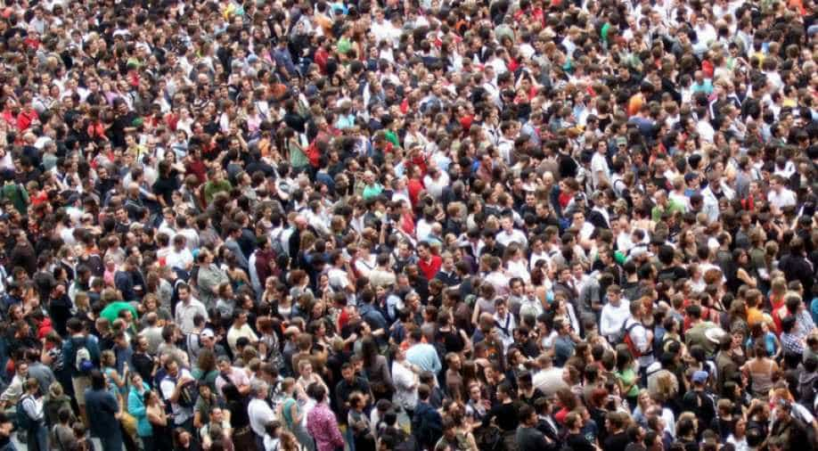
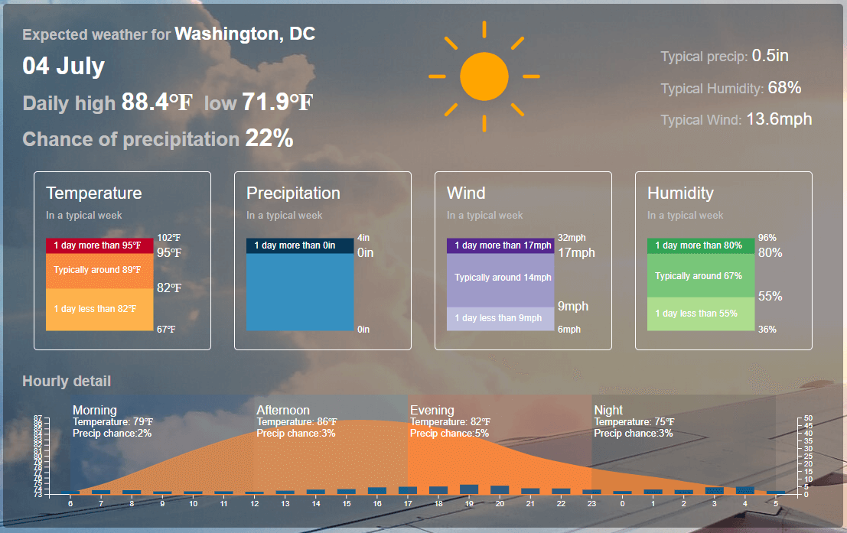
Motivation
Current Limitations:
Inadequate utilization of streetlights
Lack of localized weather data
Inefficient real-time crowd management
Vision:
Enhance urban living through smart technologies
Urbanization Challenges:
Increasing population density
Need for efficient city management
Current Limitations:
Lack of localized weather data
Inefficient real-time crowd management

Slide 3
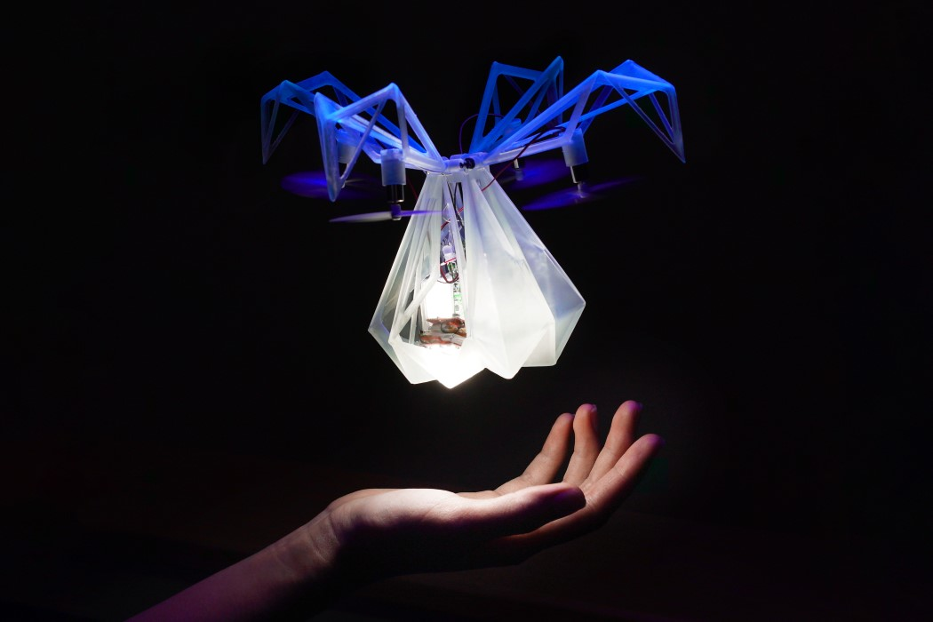
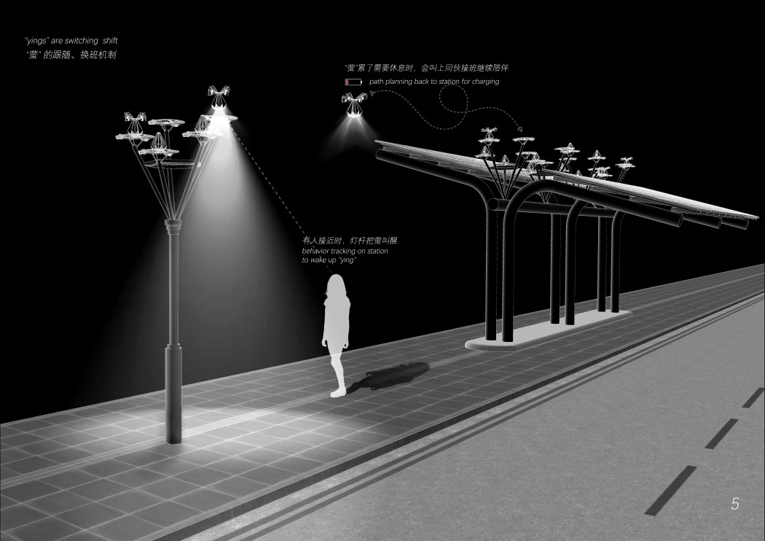
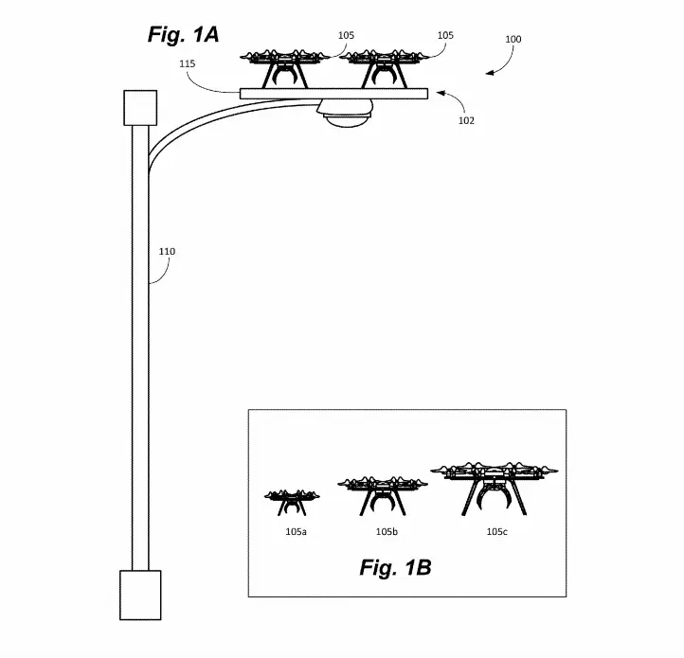
Motivation

Slide 4
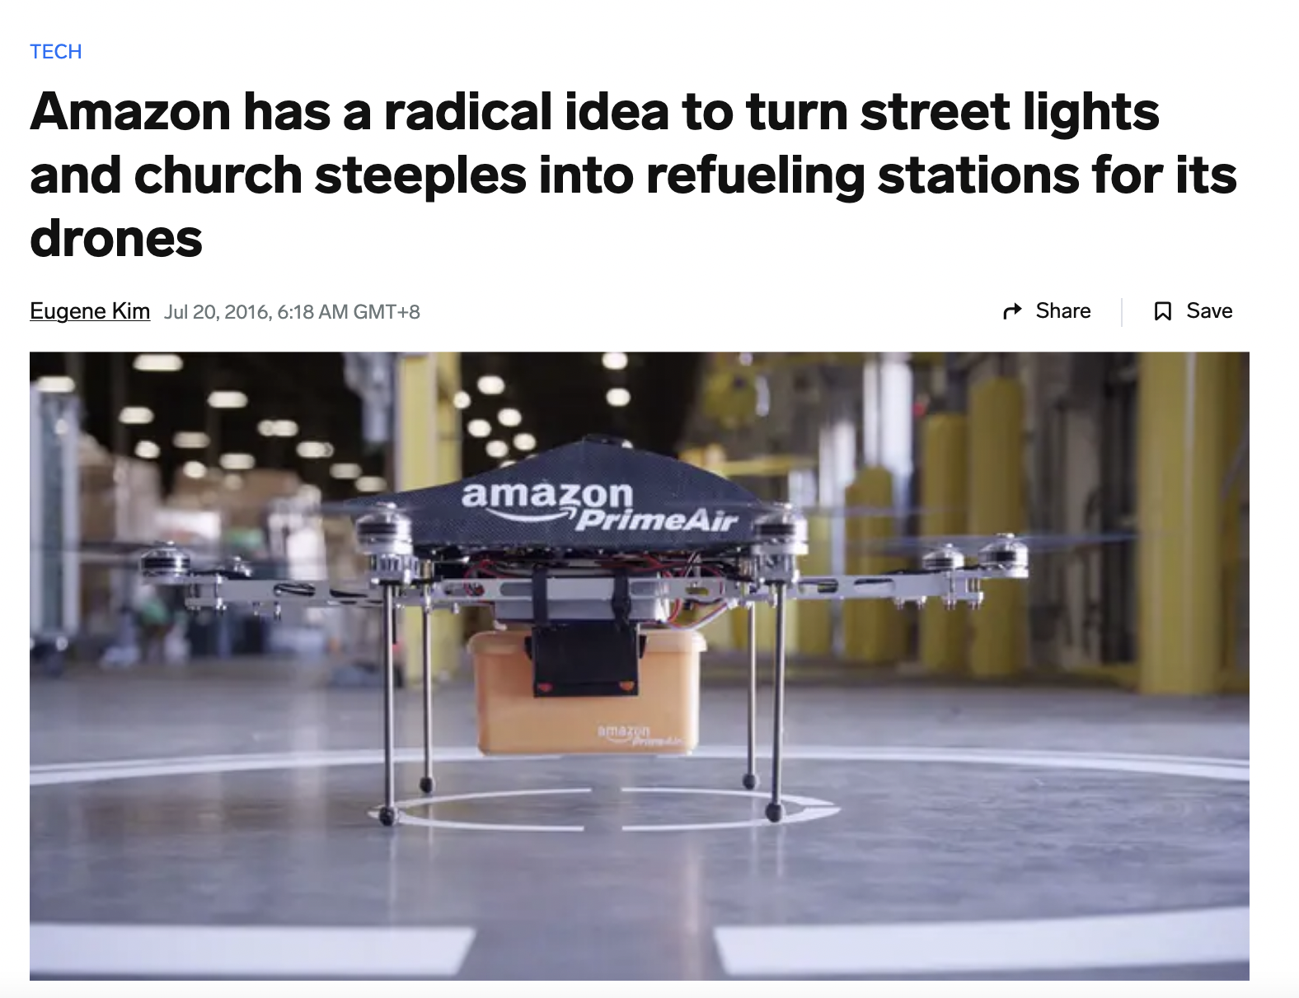
Motivation

Slide 5
OBJECTIVE
Main Goal:
Integrate IoT and drone technology into streetlights
Specific Objectives:
Provide real-time, localized weather data
Enable real-time crowd density monitoring
Improve decision-making for residents and city planners

Slide 6
SCOPE OF WORKS
想象一下，在一个炎热的夏日，你正在繁忙的城市公园中漫步。你打开智能手机上的应用程序，查看当地的天气状况。该应用程序连接到安装在公园各处路灯上的无人机，提供实时的温度、湿度和空气质量数据。你注意到空气质量开始恶化，可能是由于人群密度增加所致。

Slide 7
SCOPE OF WORKS
想象一下，在一个炎热的夏日，你正在迪士尼乐园游玩，人流拥挤。你打开智能手机上的应用程序，查看各个游玩项目的排队情况。该应用程序连接到安装在公园各处路灯上的无人机，提供实时的各个项目的排队状况图像。

Slide 8
SCOPE OF WORKS
Project Scope:
Development of an app with weather and crowd monitoring features
Installation of drones with sensors on streetlights
Key Components:
Temperature, air quality and humidity sensors for weather monitoring
Camera sensors for crowd tracking
Data privacy, transmission and processing infrastructure

Slide 9
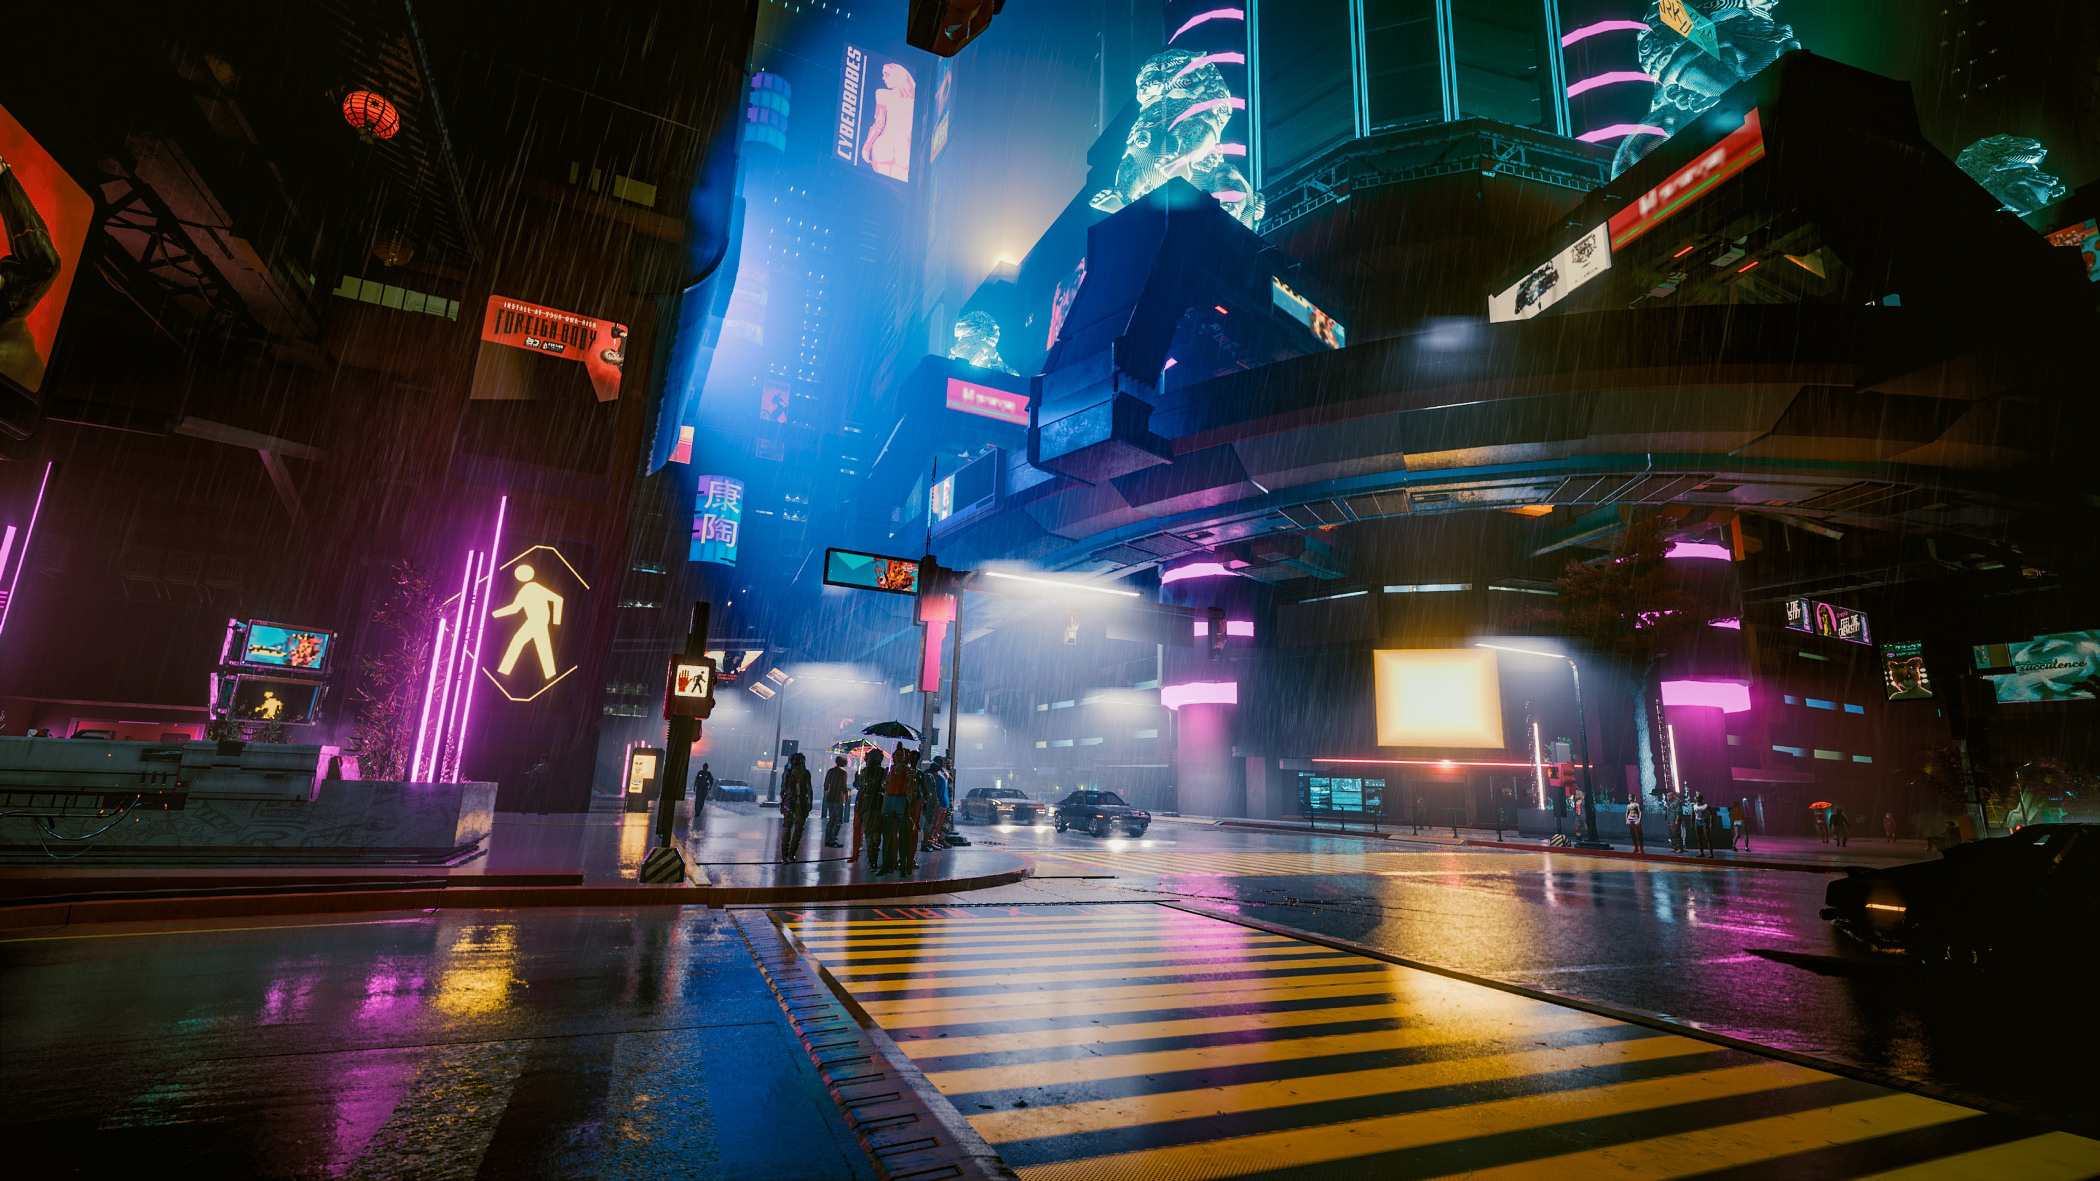
SCOPE OF WORKS Future Vision
Traffic light in CyberPunk2077

Slide 10
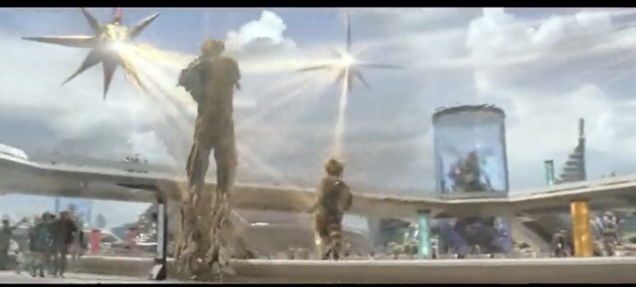
SCOPE OF WORKS Future Vision
Getting Caught on Xandar(Marvel: Guradians of the Galaxy)

Slide 11
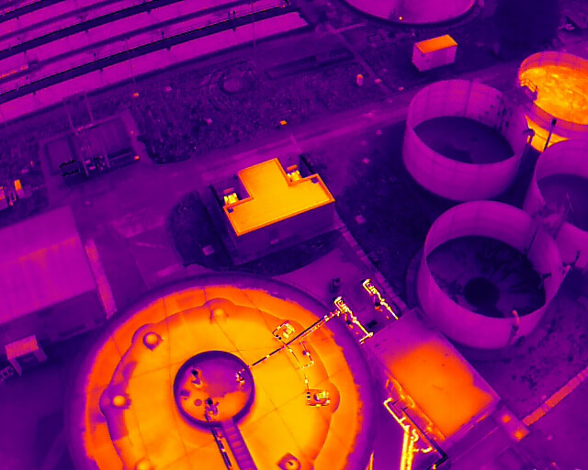
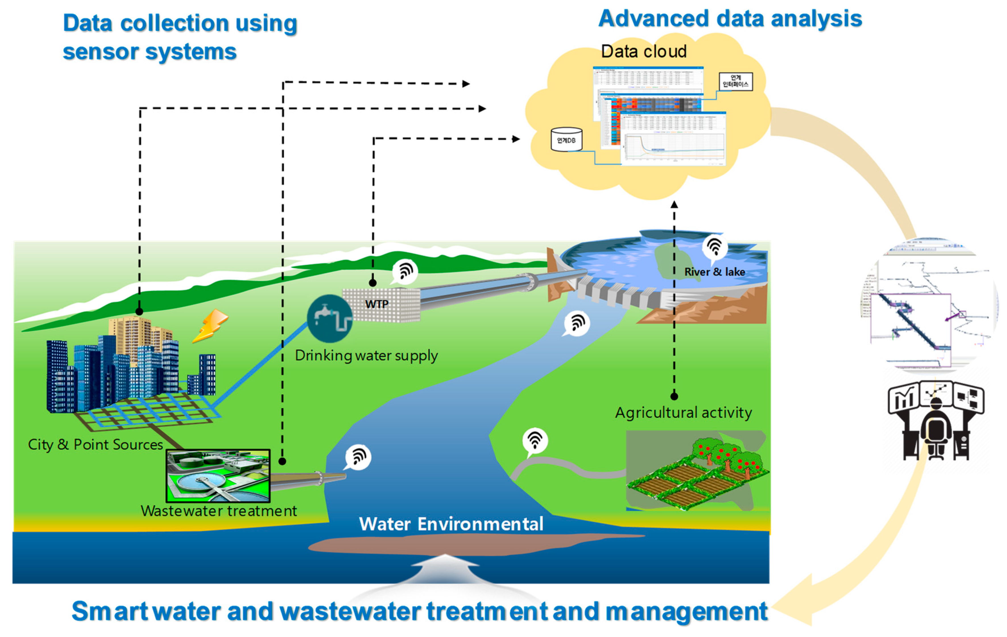
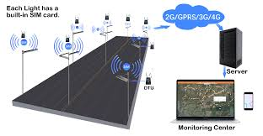
Description of Solution
Precision Weather Monitoring:
Broadcast this data through streetlight-based signals to an app, providing users with precise local weather information.
Collect real-time data at various altitudes within the urban environment.
Equip drones with temperature and humidity sensors.

Slide 12
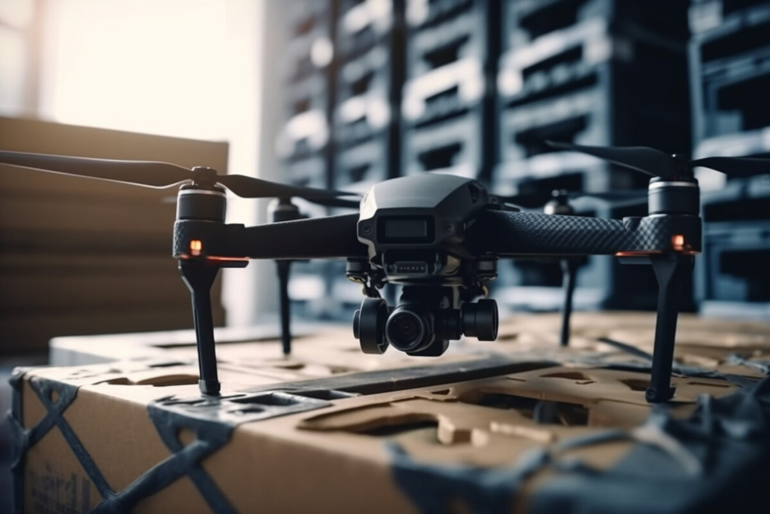
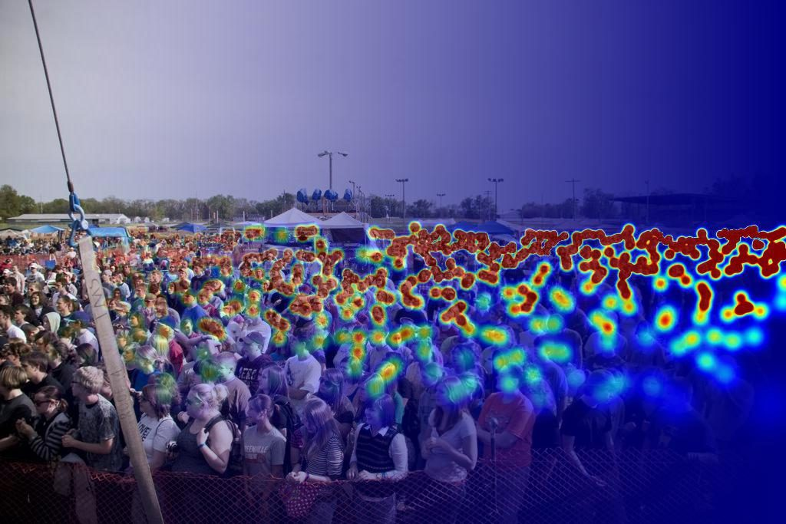
Description of Solution
Real-Time Crowd Tracking:
Use drones with camera sensors to capture real-time images of public spaces.
Apply visual recognition technologies to analyze crowd density.
Stream processed data to an app, helping users make informed decisions about navigating crowded areas.
Drones with camera sensors
Analyze the crowd density

Slide 13
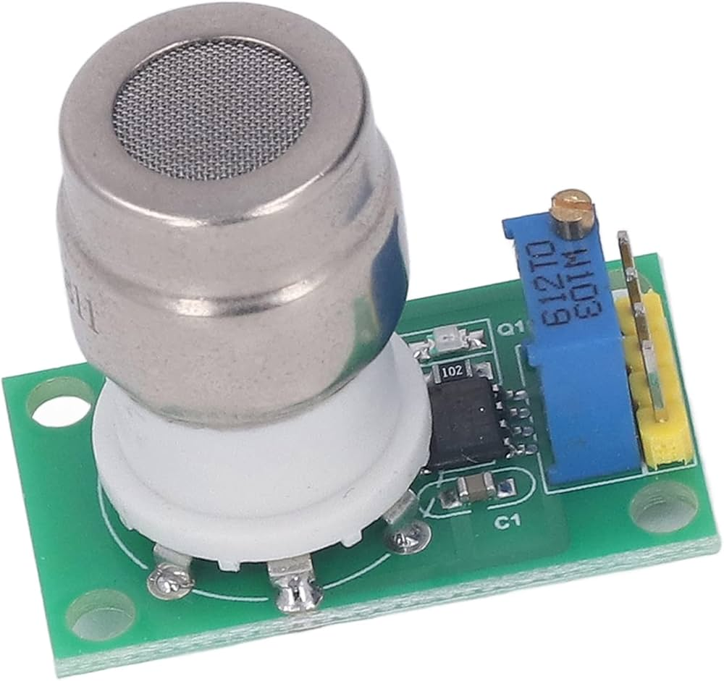
Description of Solution
Air Quality Monitoring:
Air quality sensors such as PM2.5, CO2 sensors.
Providing more comprehensive environmental data.
CO2 sensors will monitor carbon dioxide concentrations, offering insights into urban air quality and helping to identify pollution sources.
CO2 sensors

Slide 14
A literature survey
The review of existing literature has revealed some gaps in existing smart city technologies:

Slide 15
·Weather monitoring
·Crowd management
·Traffic management
·Energy management
·Environmental monitoring
·Public services
·Safety and emergency response

Slide 16
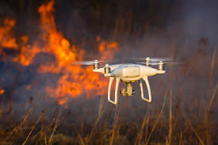
Description of Solution
Emergency Response Features:
Integrate emergency response capabilities into drones. drones can automatically fly to the site and transmit real-time data to emergency teams when anomalies are detected.
Drones can automatically fly to the anomalies site

Slide 17
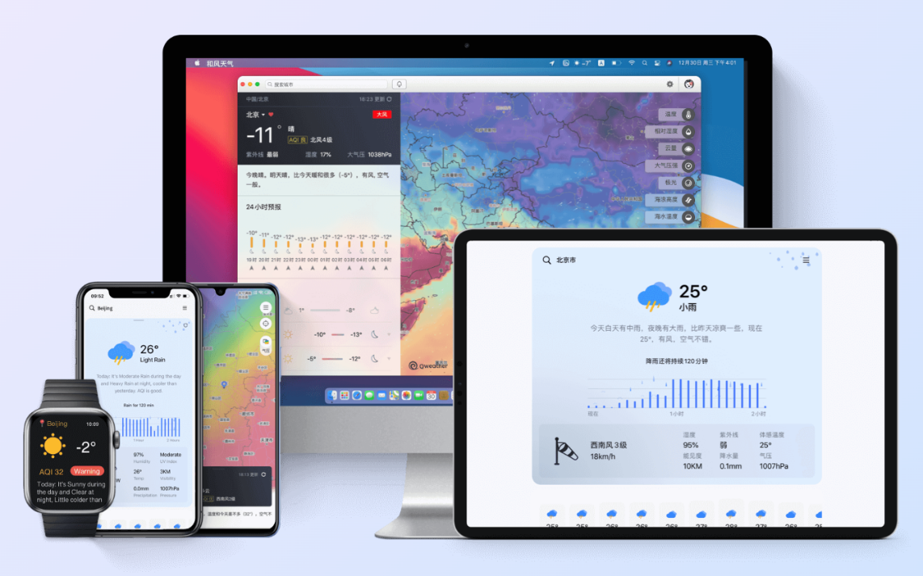
Implementation and Results
App Development
The app's design focused on user experience, ensuring that the information provided is easily accessible and actionable.
Key features of the app include:
Weather Data: Real-time updates on temperature, humidity, and air quality.
Crowd Monitoring: Live images and density analysis of public spaces, helping users to avoid crowded areas.
We developed an intuitive app that offers precise weather data and real-time crowd monitoring. The user interface was designed to be user-friendly, ensuring ease of navigation and access to critical information.

Slide 18
Implementation and Results
Sensor Integration
We equipped drones with advanced sensors for weather and crowd monitoring.
Improved Urban Living: Residents benefit from accurate weather information and real-time crowd data, enabling better planning and decision-making.
Enhanced City Management: City planners can utilize the data for more efficient resource allocation and management.
Monetization Opportunities: The system opens avenues for monetization through targeted advertising and special event services.
The installation process included:
Overall, the project demonstrated the potential of IoT and drone technology in creating smarter cities, offering practical benefits to both residents and city planners.

Slide 19
Implementation and Results
Improved Urban Living: Residents benefit from accurate weather information and real-time crowd data, enabling better planning and decision-making.
Enhanced City Management: City planners can utilize the data for more efficient resource allocation and management.
Monetization Opportunities: The system opens avenues for monetization through targeted advertising and special event services.
Results
Explore Advanced Technologies: Incorporate more sophisticated sensors and data analysis techniques.
Expand Coverage: Extend the system to cover more urban areas.
Continuous Improvement: Gather user feedback and make iterative improvements to the system.
Future Work

Slide 20
Conclusion
Summary:
Innovative use of IoT and drones for smart cities
Significant improvements in weather and crowd data accuracy
Practical benefits for residents and city planners
Future Work:
Explore more advanced technologies
Expand the system to cover more urban areas
Continuous improvement based on user feedback

Slide 21
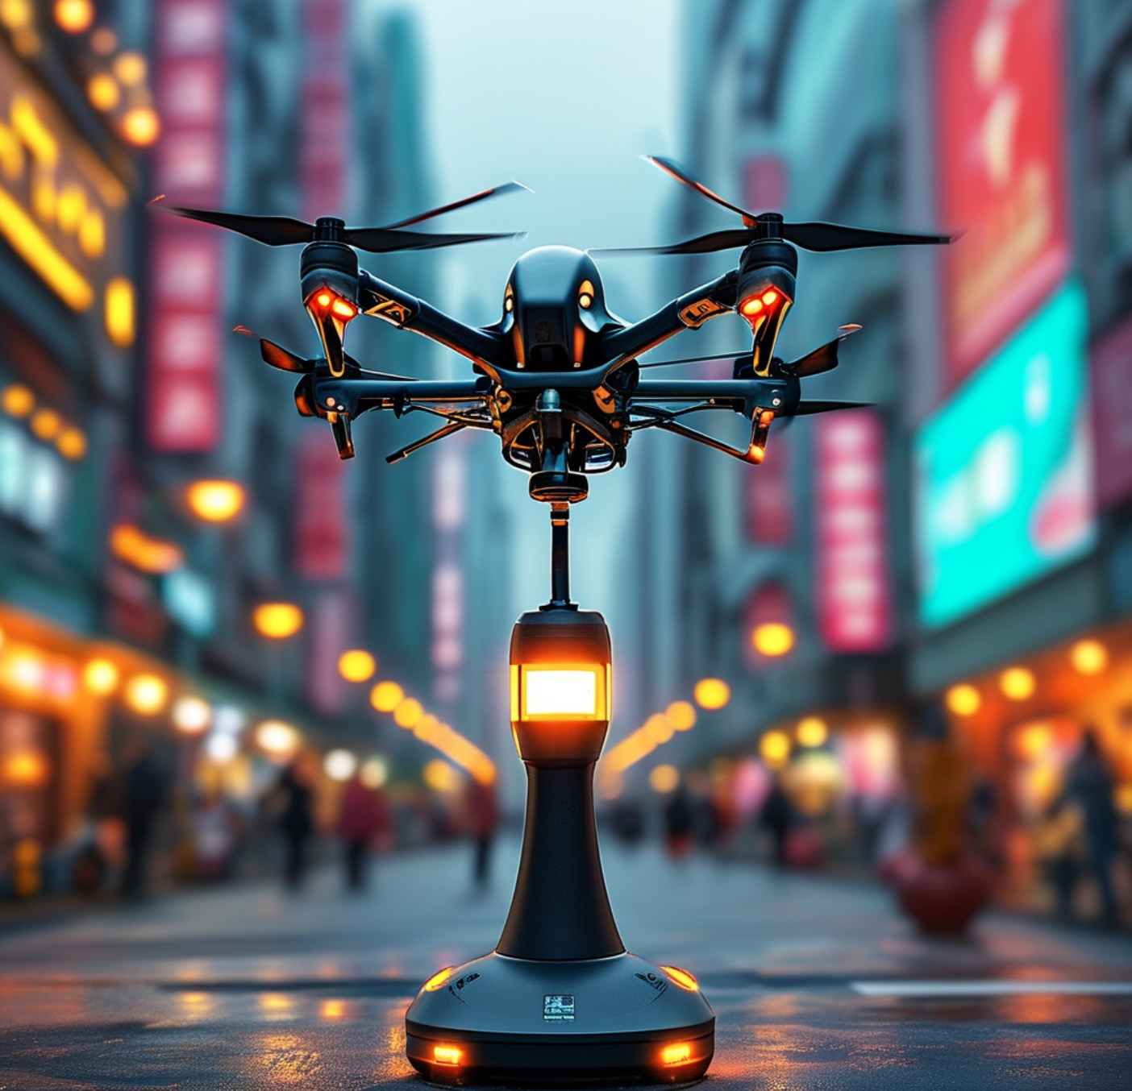
Conclusion
Innovation in Urban Infrastructure
Maximizing urban assets
Providing real-time environmental data
Enhancing quality of urban living

Slide 22
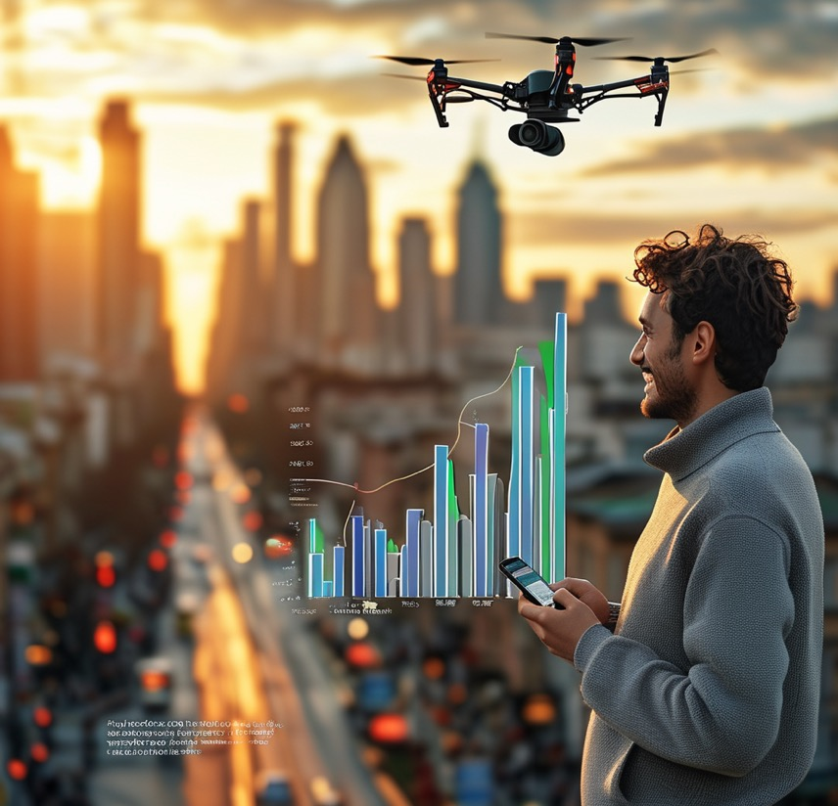
Conclusion
Impact and Outcomes
Improved decision-making
Enhanced public safety
Optimized traffic flow

Slide 23
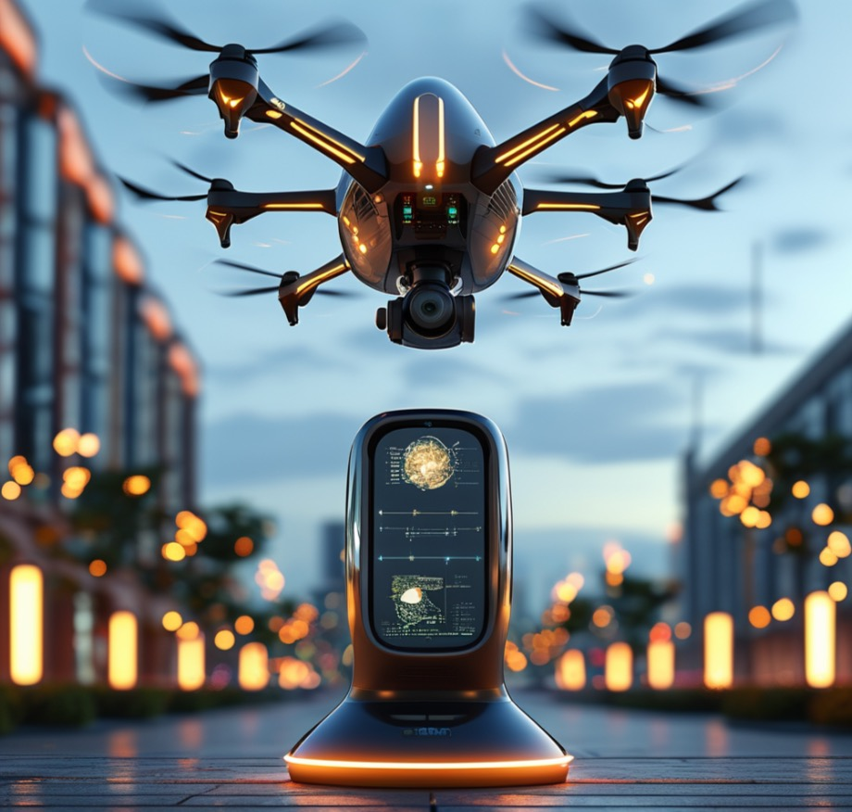
Conclusion
Future Prospects
Upgrading to advanced drones
Expanding system capabilities
Anticipating future urban challenges

Slide 24

Conclusion
Call to Action and Community Engagement
Encouraging community feedback
Promoting data sharing
Fostering a sense of shared responsibility

Slide 25
THANK YOU!

